Slide 1
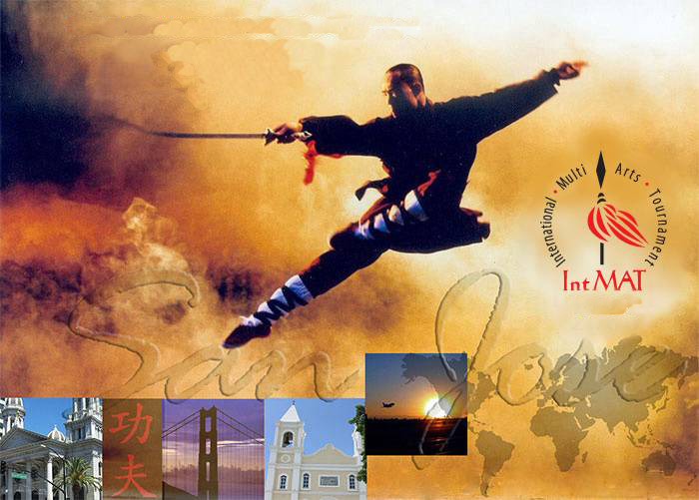

IntMAT Shaolin 2011
March 27, 2011
San Jose, California
2 0 11
Sponsors:
Support, in part, by a Cultural Affairs grant from the City of San Jose; Marchese Family Foundation
Presented by: Chinese Performing Arts of America
6148 Bollinger Road, San Jose, CA 95129
(408) 973-8276

